Slide 1


Slide 2
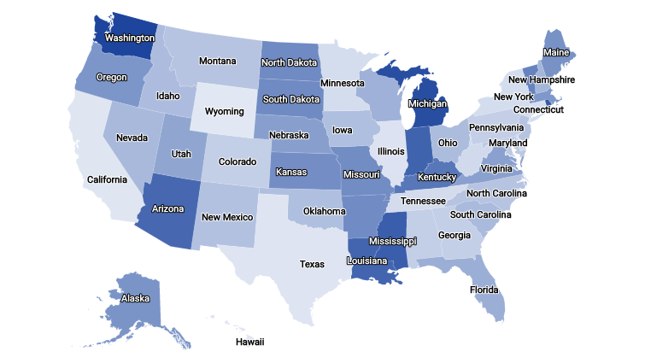
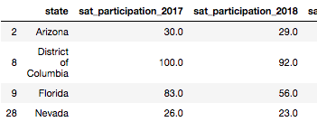

3%
27%

Slide 3
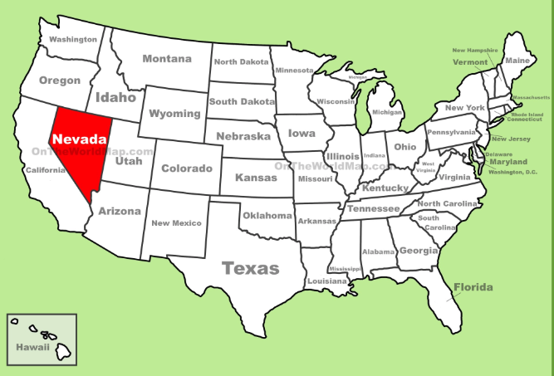
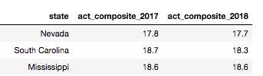
100% PARTICIPATION RATE
100% PARTICIPATION RATE
Ranked LAST in ACT score

Slide 4
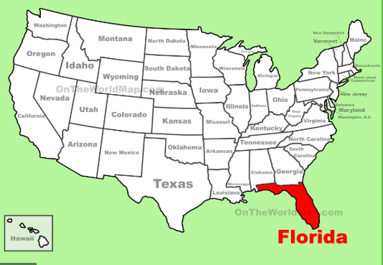
Ranked 6th in 2017 (Based on SAT)
Ranked 13th in 2018
Based on ACT
Ranking based on Majority participation in an exam**

Slide 5
WHY SAT

Slide 6
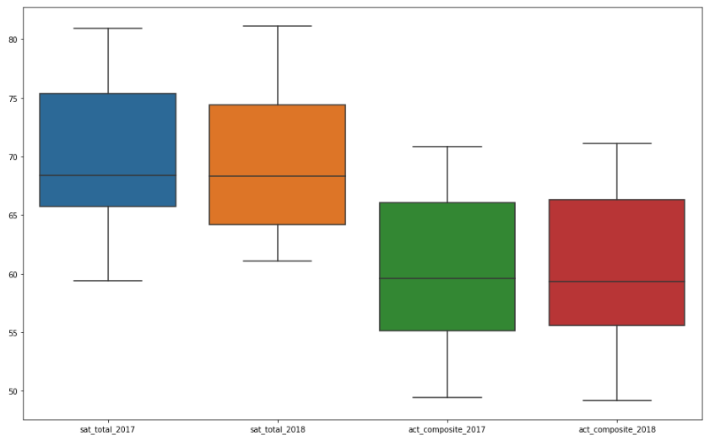
SAT
11%
BETTER
ACT
AVERAGE FINAL SCORE IN PERCENTAGE

Slide 7
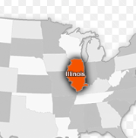
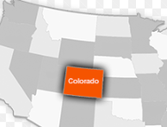
RANKINGS
12th
11th
2018
PROVE?
2017
24th
26th
Ranking Based on Majority Participation

Slide 8



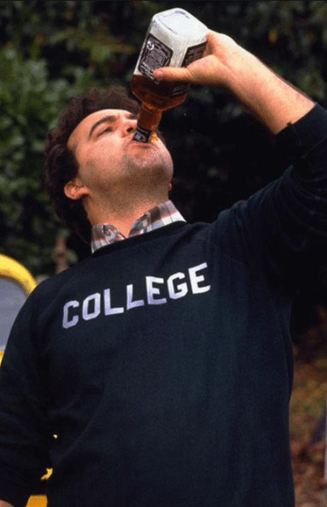
After school hours tuition
HOW
Encourage College Culture

